Slide 1

Going Green - With Envy
W241 - Experiments and Causality
Ram Balasubramanian, Tarun Chopra, Cynthia Hu, Yang Yang Qian
Notes:
Ram

Slide 2
Research Question
Can we improve participation in recycling through social comparison?
“Opower meets Recycling”
Notes:
Ram
The basic research question for our experiment was to figure out if we can improve recycling in the US by means of social comparison. Think of this as the Opower paper that we all read about on social comparison for the use of electricity - applied to recycling.j

Slide 3
Background + Motivation
US Recycling Rate: 35% (#25 in the world)
Germany #1 (65%)
Notes:
Ram
So why did we pick this question? Well, we live in a world there is just more and more of us, and we keep generating more and more trash. In the US we generate about 7lbs of trash per capita every day! A lot of that trash is recyclable material - materials made of plastic that takes 400 years to decompose and be carbonized. Yet, our recycling rate as a country is quite low - 35%. We are ranked #25 in the world - Germany is ranked #1 with 65% recycling rate. How can the US become #1?

Slide 4
Experiment Design - Concept
Target Population
Treatment
Outcome
Notes:
Ram
Well, we took our high-level motivation for an experiment and based on our readings in the class, wondered if social comparison could be used as a tool to motivate people to recycle more. In order to conduct an experiment to test our hypothesis, we needed to figure out -> whom we are targeting, what sort of treatment we are going to provide them and how we are going to measure if the treatment had any impact.

Slide 5
Experiment Design - Operationalized
Target Population
MoCo, MD
~400 houses
“Non-recyclers”
Treatment
Direct mail postcard
How to recycle
Social Comparison
Outcome
Recycle “Put-out” rate
Notes:
Ram
After brainstorming several ideas - which included doing an experiment in elementary school with kids to sending out a survey on mturk to get a sense for how people might react to social comparison information - we took David and Alex’s advice and embarked on a real-world field experiment. We picked Montgomery County - where i live; where recycling pick up happens once a week. We met with the Dept. of Environ. Protection for the county, got a good understanding of the current state of recycling in MoCo. Based on all that information - we decided our target population would be “non-recyclers” - those who are not currently pariticipating in recycling and treat them with a flyer which would compare their neighborhood’s recycling rates to the county’s overall recycling rate. Measurement was going to be somewhat tricky. Our meeting with the county officials revealed that MoCo collects a ton of data - but it is not at household level. Given our limited resources, we could not rely on the county data (which wasn’t available readily). We decided on a simple measure - we would drive around and simply indicate whether a house participated in recycling or not - by looking at if they put out a recycle bin on scheduled collection day.

Slide 6
Experiment - Timeline
Treatment
(Split Target into Control and Treatment groups))
Send out flyers via mail
Pre Experiment Scouting
Select Potential Neighborhoods
12 - Mar
02-Apr
28 - Feb
22-Mar
Pre Treatment Measurements
(TARGET POPULATION)
Identify households that don’t “participate”.
Post-Treatment Measurement
Notes:
Ram
Given our tight timeline for the class, here is what we were able to do. We did a week of pre-experiment scouting. What if every single house participated already?? Fortunately for us, we were able to find two neighborhoods where the participation rate was around 50%. This was based on just 1-week’s observation. Once we landed on which neighborhoods to focus on, we took a pre-treatment measurement to identify which houses were not participating in the program. This is our target population. We then split the target population into control and treatment groups - we randomized by street cluster (just incase neighbors talked about the treatment). We sent the treatment group - the following flyer.

Slide 7


Notes:
Ram

Slide 8

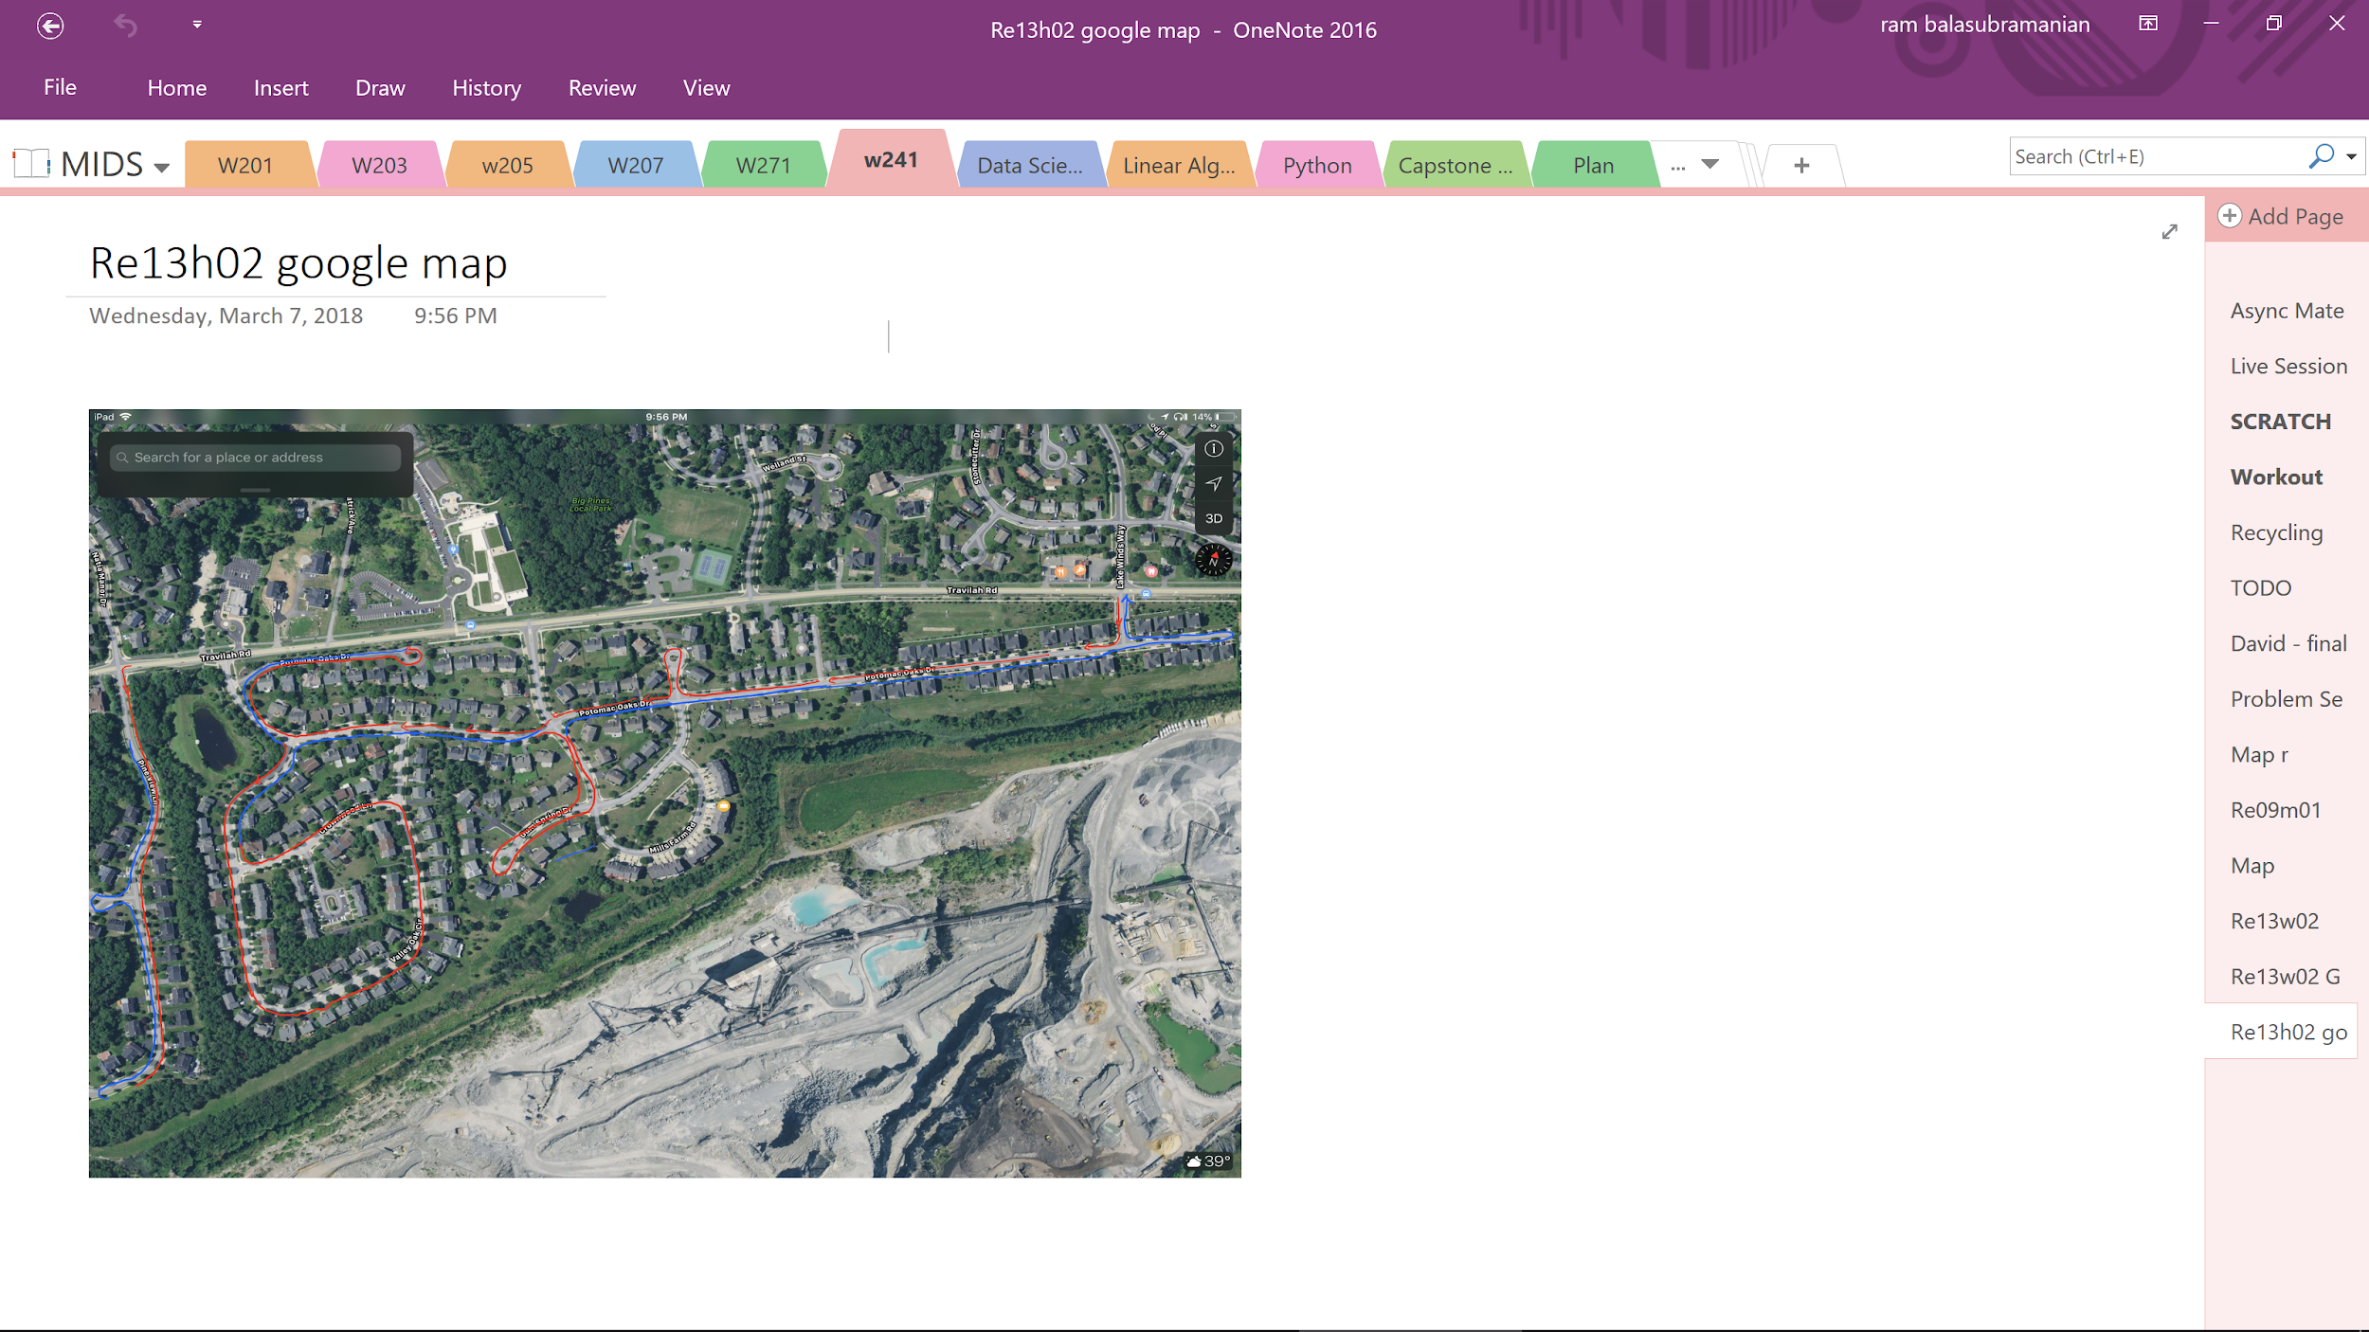
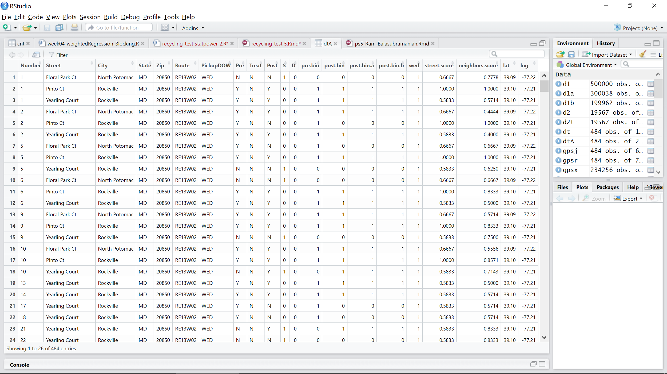
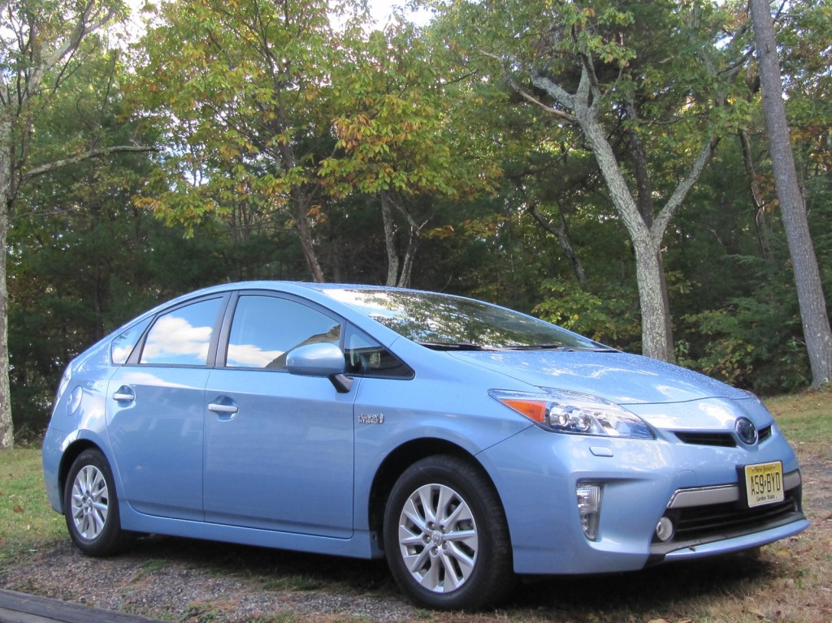
Data Collection
Notes:
Ram
So how did we actually collect the data?
Gopro + Prius!

Slide 9
Data Flow
484 Single-Family Household
27 streets
Pre-treatment Non-participants
(TARGET)
Pre-treatment Participants
186 Single-Family Household
25 streets
298 Single-Family Household
27 streets
Treatment Group
Control Group
102 Single-Family Household
13 streets
84 Single-Family Household
12 streets
Notes:
Ram
Here are the details of the data that we collected ->
There were 484 single family homes that we studied. Roughly 40% of those (186 homes) were in our target population - they did not participate in the pre-treatment period. We split them roughly 50/50 into treatment and control groups - we employed a cluster design where residents on the same street were either treatment or in control. We then measured the post treatment participation rate for both the treatment and control groups.

Slide 10
Covariate Balance
Anova test on two models:
D ~ 1
D ~ 1 + street.score + neighbors.score + wed
Results:
P-value = 0.0001897
Randomization was not completely random across all covariates
Notes:
Yang
We compared a short and long model to check if our randomization work
we have a low p-value of 0.0001897
Indicates that our covariates actually predicts our treatment group
unfortunately, it looks like we didn't quite split our assignment to treatment and control fairly with regards to these covariates
But that is explainable, because our design randomized by street, and did not actively balance across covariates
Analysis of Variance Table
Model 1: D ~ 1
Model 2: D ~ 1 + street.score + neighbors.score + wed
Res.Df RSS Df Sum of Sq Pr(>Chi)
1 185 46.065
2 182 41.552 3 4.5128 0.0001897 ***

Slide 11
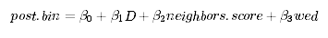
Model
 | Street | Houses’ street, our cluster variable
post.bin | Post | Outcome variable, likelihood a house will put out a bin (0 to 1)
neighbors.score | Neighbors Score | Ratio of number of Pre=Y, to the number of neighbors, for each house (neighbor defined as 0 > distance < 60 meters)
wed | Route, PickupDOW | Dummy variable, proxy for Route and Pick-up Day of Week, either Wed or Thurs
Notes:
Yang
neighbor.score
A house whose nearby neighbors recycle, might be more inclined to recycle
Grabbed gps data from Google geolocation API
draw a radius of 60 meters, and count the bins within that radius
wed
A house in a certain route, or pickup day, might be different from a house on another route, with a different pickup day

Slide 12
Estimated Model Parameters:
N = 182 | Short | Long
Treatment | -0.101 (0.095) | -0.065 (0.070)
Neighbors Score |  | 0.094 (0.213)
Pickup (Wed) |  | 0.185*** (0.071)
Constant | 0.425*** (0.070) | 0.242** (0.118)
R2 | 0.011 | 0.050
Anova LRT, Short vs Long
P- value: 0.02471 *
Notes:
Yang
Model:
We had 182 observations to use in our regression
Units here are 0.percentage, e.g. potential outcome to control is 42% likelihood to put out a bin
The basic short model showed a non-statistically significant negative potential outcome to treatment of -0.101, with a ci of (-0.2436059 0.04066474), crossing 0
The basic long model showed a non-statistically significant positive potential outcome to treatment of -0.065, with a ci of (-0.20819741 0.07750162), crossing 0
Conclusions:
We did not find any statistically significant results for our Treatment
Therefore, we cannot reject our null hypothesis that our treatment had no effect
Boundary analysis:
We had 5 missing records due to measurement errors
If we assume they all would NOT have put out a bin, using the long model
Treatment effect would have been -0.044 (0.076)
If we assumed they would have put out a bin, using the long model
Treatment effect would have been -0.089 (0.068)
Neither were statistically significant
*p<0.1; **p<0.05; ***p<0.01
Coefci
Short
2.5 % 97.5 %
(Intercept) 0.3185939 0.53140608
D -0.2436059 0.04066474
Long
2.5 % 97.5 % (Intercept) 0.03847611 0.44606538 D -0.20819741 0.07750162 neighbors.score -0.17027578 0.35744712 wed 0.03990322 0.32969665
Analysis of Variance Table Model 1: post.bin ~ D Model 2: post.bin ~ D + neighbors.score + wed Res.Df RSS Df Sum of Sq Pr(>Chi) 1 180 41.874 2 178 40.202 2 1.6716 0.02471 * --- Signif. codes: 0 ‘***’ 0.001 ‘**’ 0.01 ‘*’ 0.05 ‘.’ 0.1 ‘ ’ 1

Slide 13
Concluding Thoughts
Limitations
Number of experimental units
Measurement of bins vs recyclables
Unknown application rate
Detecting heterogeneous treatment effects
Spillover effects
Limited generalization
Future Opportunities
Collect data for longer-period of time after the treatment is complete
Use a different treatment for each period
Have a larger experiment
Notes:
Yang
It’s difficult to change people’s behavior and form a new habit, such as recycling.
Limitations
One of our biggest limitation was the number of experimental units we could apply treatment to, and reliably measure
So we ran a power test, given our treatment effect and experimental size
Note, we used our short model’s results for this power test
Our power was 0.275, that we could have only correctly detected there is likely “not“ no effect, about 27% of the time
We couldn’t find a systematic way to measure the actual recyclable material, so we decided to measure bins
However, this does mean we can’t see exactly what is in the bins
And we can’t tell if our subjects are putting out half full bins,
Or are just mixing their trash with their bins
We couldn’t find a systematic way to determine the application rate
So we had to calculate the intent-to-treat instead of the complier-average-causal-effect
There could be many other factors that affect treatment effect size
But our experiment couldn’t detect any statistically significant interactions
Perhaps we could also be more careful about our blocking in the future
Spillover effects
Our cluster random assignment was designed to mitigate spillover due to geographic proximity
But it doesn’t address other kinds of social connections, e.g. internet or social groups
And it doesn’t address intertemporal substitutions, e.g. got a card, toss out handy bottles, forget to do the same next week
Generalization
Our experiment purposely filtered out all Pre=Y, for a single county in Penn
This might not generalize very well to other populations
Opportunities and ideas for the future
Ideally for future experiments, we would treat our subjects with different treatments several times,
Social vs other kinds of treatment, like how David Brookman did his
Quarterly or even monthly
Then try to detect if the treatment effect dissipate or persist

Slide 14
Appendix - Data Dictionary
Field | Comments
Street | Houses’ street, our cluster variable
Number, City, State, Zip | Houses’ address, city, state, and zip code
Route, PickupDOW | Route ID and Pick-up Day of Week, either Wed or Thurs
Pre | Y/N indicator for whether we saw a bin before treatment
Post | Y/N indicator for whether we saw a bin after treatment
Treat | Y/N indicator for whether the house was assigned to treatment or control
Street Score | Ratio of number of Pre=Y, to number of houses on the street, for each street
Neighbors Score | Ratio of number of Pre=Y, to the number of neighbors, for each house (neighbor defined as 0 > distance < 60 meters)

Slide 15
Estimated Model Parameters:
N = 182 | Short | Long
Treatment | -0.101 (0.095) | 0.363 (0.415)
Street Score |  | 0.051 (0.842)
Neighbors Score |  | 0.116 (0.182)
Pickup (Wed) |  | 0.236 (0.225)
Constant | 0.425*** (0.070) | 0.163 (0.390)
Treatment x Street Score |  | -0.899 (0.900)
Treatment x Neighbors Score |  | 0.223 (0.372)
Treatment x Pickup (Wed) |  | -0.123 (0.234)
R2 | 0.011 | 0.086
Anova
Short vs Long
P- value: 0.02687 *
Notes:
Yang
Model:
We had 182 observations to use in our regression
Units here are 0.percentage, e.g. potential outcome to control is 42% likelihood to put out a bin
The basic short model showed a non-statistically significant negative potential outcome to treatment of -0.101
The basic long model showed a non-statistically significant positive potential outcome to treatment of 0.363
Conclusions:
We did not find any statistically significant results
Therefore, we cannot reject our null hypothesis that our treatment had no effect
We were also interested in
Why our treatment effect in the short model was negative
perhaps because of the negative effects from the interaction terms
If our ITT effect differed among types of streets, types of neighbors, or routes (Heterogeneous treatment effect)
Unfortunately, we did not find any statistically significant results
Boundary analysis:
We had 5 missing records due to measurement errors
If we assume they all would NOT have put out a bin, using the long model
Potential outcome to treatment would have been 0.461 (0.436)
If we assumed they would have put out a bin, using the long model
Potential outcome to treatment would have been 0.261 (0.409)
Neither were statistically significant
*p<0.1; **p<0.05; ***p<0.01
Coefci
Short
2.5 % 97.5 %
(Intercept) 0.3185939 0.53140608
D -0.2436059 0.04066474
Long
(Intercept) -0.9207798 1.2470747
D -0.7706878 1.4961436
street.score -2.2753228 2.3766952
neighbors.score -0.2904311 0.5221454
wed -0.3281627 0.8003929
D:street.score -3.3221137 1.5241149
D:neighbors.score -0.3641064 0.8099257
D:wed -0.7168267 0.4713567
Analysis of Variance Table
Model 1: post.bin ~ D
Model 2: post.bin ~ D + street.score + neighbors.score + wed + street.score * D + neighbors.score * D + wed * D
Res.Df RSS Df Sum of Sq Pr(>Chi)
1 180 41.874
2 174 38.702 6 3.1716 0.02687 *
---
Signif. codes: 0 ‘***’ 0.001 ‘**’ 0.01 ‘*’ 0.05 ‘.’ 0.1 ‘ ’ 1

Slide 16
Model
 | Street | Houses’ street, our cluster variable
post.bin | Post | Outcome variable, likelihood a house will put out a bin (0 to 1)
street.score | Street Score | Ratio of number of Pre=Y, to number of houses on the street, for each street
neighbors.score | Neighbors Score | Ratio of number of Pre=Y, to the number of neighbors, for each house (neighbor defined as 0 > distance < 60 meters)
wed | Route, PickupDOW | Dummy variable, proxy for Route and Pick-up Day of Week, either Wed or Thurs
Notes:
Yang
street.score
A house on a street where lots of households recycle, might be more inclined to recycle
Calculated as the mean of bins per street
neighbor.score
A house whose nearby neighbors recycle, might be more inclined to recycle
Grabbed gps data from Google geolocation API
draw a radius of 60 meters, and count the bins within that radius
wed
A house in a certain route, or pickup day, might be different from a house on another route, with a different pickup day

Slide 17
Treatment Effect
N = 182 | Short | Long
Treatment | -0.101 (0.095) | 0.363 (0.415)
Street Score |  | 0.051 (0.842)
Neighbors Score |  | 0.116 (0.182)
Pickup (Wed) |  | 0.236 (0.225)
Constant | 0.425*** (0.070) | 0.163 (0.390)
Notes:
Yang
Model:
We had 182 observations to use in our regression
Units here are 0.percentage, e.g. potential outcome to control is 42% likelihood to put out a bin
The basic short model showed a non-statistically significant negative potential outcome to treatment of -0.101
The basic long model showed a non-statistically significant positive potential outcome to treatment of 0.363
Conclusion:
We did not find any statistically effect of applying our treatment
We ran short and long models, to see if our coefficients changed
They did but not too much
Our treatment effect in the short model was negative, because of the large negative contributions from other terms (reference next slide)
*p<0.1; **p<0.05; ***p<0.01

Slide 18
Treatment Effect Continued
N = 182 | Short | Long
Treatment and Street Score |  | -0.899 (0.900)
Treatment and Neighbors Score |  | 0.223 (0.372)
Treatment and Pickup Wed |  | -0.123 (0.234)
R2 | 0.011 | 0.086
Notes:
Yang
We were also interested in
Why our short model showed negative treatment effect
If our ITT effect differed among types of streets, types of neighbors, or routes (Heterogeneous treatment effect)
Unfortunately, we did not find any statistically significant effects
Boundary analysis:
We had 5 missing records due to measurement errors
If we assume they all would NOT have put out a bin, using the long model
Potential outcome to treatment would have been 0.461 (0.436)
If we assumed they would have put out a bin, using the long model
Potential outcome to treatment would have been 0.261 (0.409)
Neither were statistically significant

Slide 19
Resuts
WOULD IT MAKE SENSE TO INSERT FINAL REGRESSION MODEL WITH ACTUAL ESTIMATED PARAMETERS?
ADD 95% CONFIDENCE INTERVALS FOR THE TREATMENT EFFECT COEFFICIENT: (-LOWER, +UPPER) - THAT SHOULD SHOW THAT IT INCLUDES “0”

Slide 20

Did You Know?
“Americans toss nearly 700 plastic bottles a day.”
“An average american throws more than 7lb of trash a day.”
“It takes over 400 years for plastic to decompose.”
Notes:
Tarun

Slide 21
Why Recycling?
(In 2007, 757,000 jobs, $36.6 B in wages, $6.7 B in tax revenue from recycling activities)
1. | Waste reduction
2. | Conservation of natural resources
3. | Pollution reduction
4. | Saving in energy consumption
Notes:
Tarun
- Waste reduction that is being sent to landfills.
- Conservation of natural resources like wood, water and minerals.
- Pollution reduction by reducing the need for the creation of new raw materials.
- Savings in energy consumption by reusing existing products to building new products.

Slide 22
Estimated Model Parameters:
N = 182 | Short | With Covariates
Treatment | -0.10 (0.07) | -0.07 (0.07)
Neighbors Score |  | 0.09 (0.14)
Pickup (Wed) |  | 0.18* (0.07)
Constant | 0.425*** (0.06) | 0.24* (0.01)
R2 | 0.005 | 0.034
Notes:
Yang
Model:
We had 182 observations to use in our regression
Units here are 0.percentage, e.g. potential outcome to control is 42% likelihood to put out a bin
The basic short model showed a non-statistically significant negative potential outcome to treatment of -0.101
The basic long model showed a non-statistically significant positive potential outcome to treatment of 0.363
Conclusions:
We did not find any statistically significant results
Therefore, we cannot reject our null hypothesis that our treatment had no effect
We were also interested in
Why our treatment effect in the short model was negative
perhaps because of the negative effects from the interaction terms
If our ITT effect differed among types of streets, types of neighbors, or routes (Heterogeneous treatment effect)
Unfortunately, we did not find any statistically significant results
Boundary analysis:
We had 5 missing records due to measurement errors
If we assume they all would NOT have put out a bin, using the long model
Potential outcome to treatment would have been 0.461 (0.436)
If we assumed they would have put out a bin, using the long model
Potential outcome to treatment would have been 0.261 (0.409)
Neither were statistically significant
*p<0.1; **p<0.05; ***p<0.01
Coefci
Short
2.5 % 97.5 %
(Intercept) 0.3185939 0.53140608
D -0.2436059 0.04066474
Long
(Intercept) -0.9207798 1.2470747
D -0.7706878 1.4961436
street.score -2.2753228 2.3766952
neighbors.score -0.2904311 0.5221454
wed -0.3281627 0.8003929
D:street.score -3.3221137 1.5241149
D:neighbors.score -0.3641064 0.8099257
D:wed -0.7168267 0.4713567
Analysis of Variance Table
Model 1: post.bin ~ D
Model 2: post.bin ~ D + street.score + neighbors.score + wed + street.score * D + neighbors.score * D + wed * D
Res.Df RSS Df Sum of Sq Pr(>Chi)
1 180 41.874
2 174 38.702 6 3.1716 0.02687 *
---
Signif. codes: 0 ‘***’ 0.001 ‘**’ 0.01 ‘*’ 0.05 ‘.’ 0.1 ‘ ’ 1

Slide 23
Social Comparison Theory
“We determine our own social and personal worth based on how we stack against each others”
Leon Festinger, 1954
Notes:
Tarun

